Slide 1

Education ATAR vs Geolocation
GROUP 6
Josh Martin
Peregrin Ryan
Udeshi Pereira

Slide 2


Motivation:
Our group was interested in investigating the relationship between Geolocation access to education as well as the effect of School sector (Private and Public) has on education academic success.

Slide 3

If students within Major Cities such as Melbourne or Geelong, that also receive Private, Non-Gov education then we expect them to have best chance of academic success within Victoria
Hypothesis:
This Photo by Unknown Author is licensed under CC BY-NC

Slide 4

The way we measure academic success was measuring ATAR Score

Slide 5
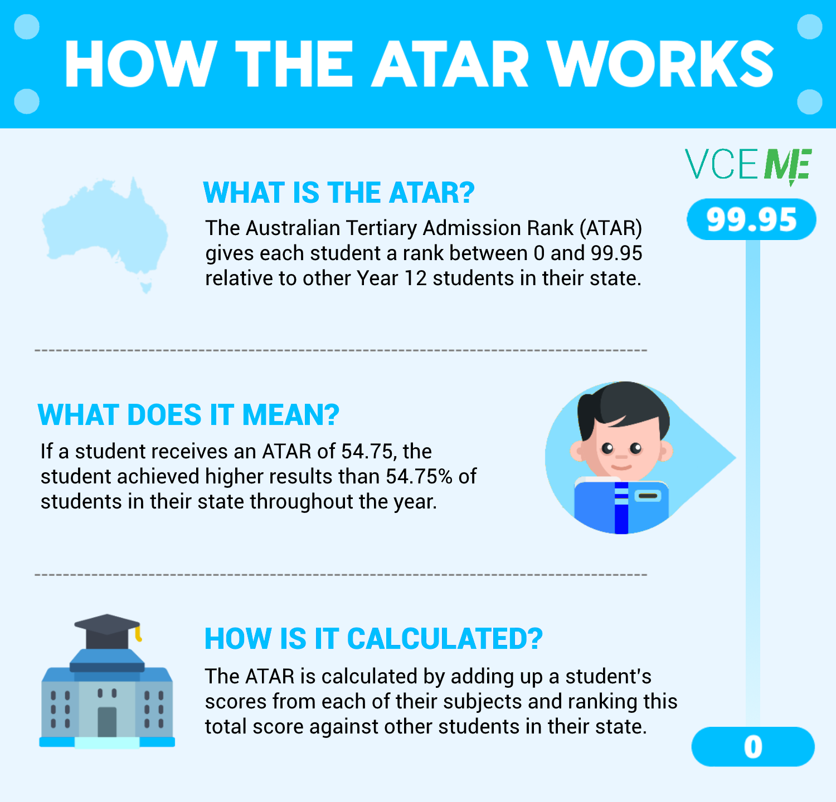
Notes:
From my notes

Slide 6


Slide 7
QUESTIONS
Is there a relationship with Geolocation academic success?
Is there a relationship with Geolocation and the choices of schools?
Which school sector has their best academic success?

Slide 8

Data cleaning process
Josh Martin

Slide 9
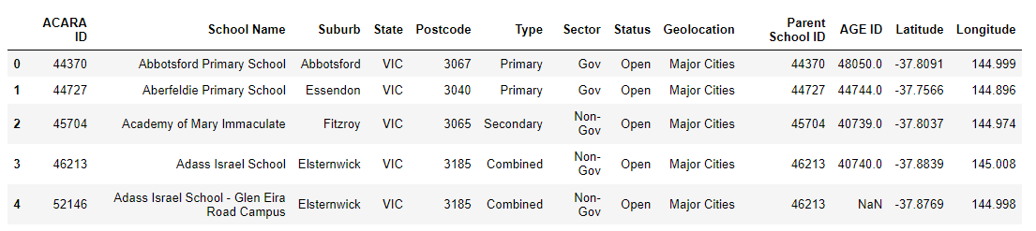
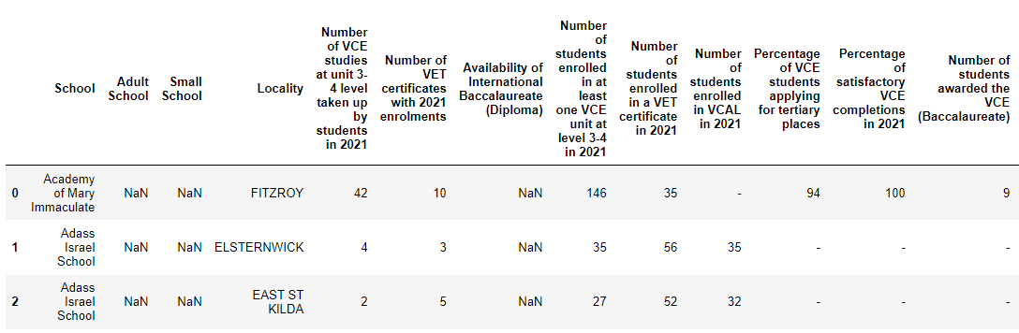
RAW Data
ASL website
VCAA website

Slide 10
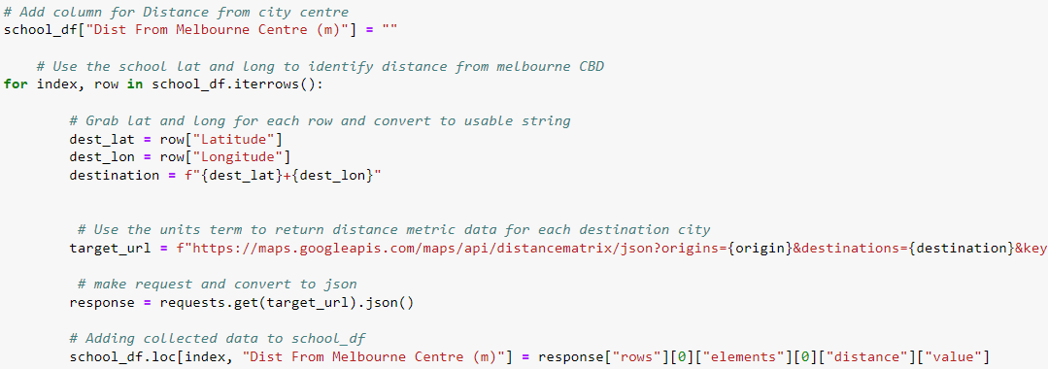
RAW Data
VCAA website
Distance for each school from a static location

Slide 11
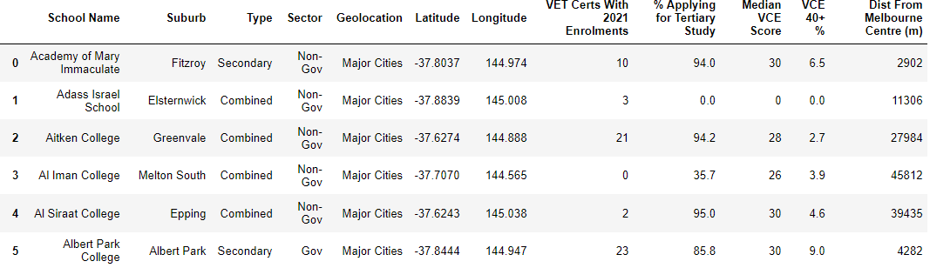
RAW Data
VCAA website
Clean Data Ready For Analysis

Slide 12
DATA Analysis
PEREGRIN RYAN

Slide 13
Defining Geolocation
Major city (Melbourne and Geelong)
Provincial city (e.g., Ballarat and Bendigo)
Provincial centre (e.g., Mildura, Swan Hill)
Large town (e.g., Leongatha, Lorne)
Small town (e.g., Terang, Skipton)
Rural (e.g., Bright, Donald)
Remote (e.g., Orbost).

Slide 14
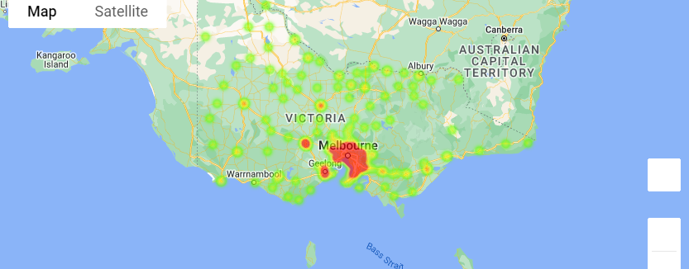
School Geolocation heatmap

Slide 15
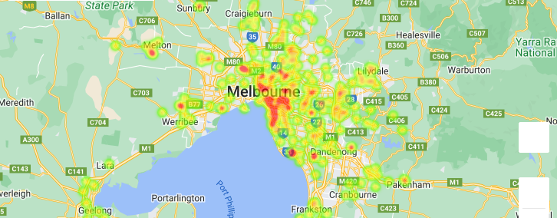
School Geolocation heatmap Major Cities

Slide 16
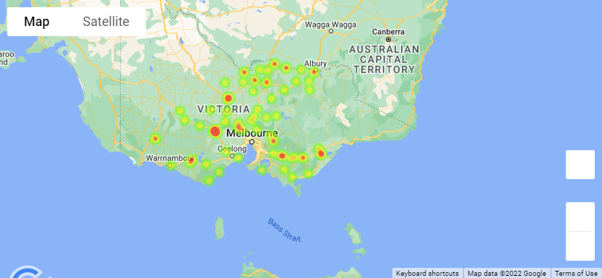
School Geolocation heatmap Inner Regional

Slide 17
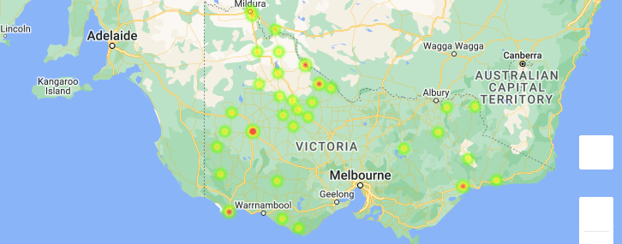
School Geolocation heatmap Outer Regional

Slide 18
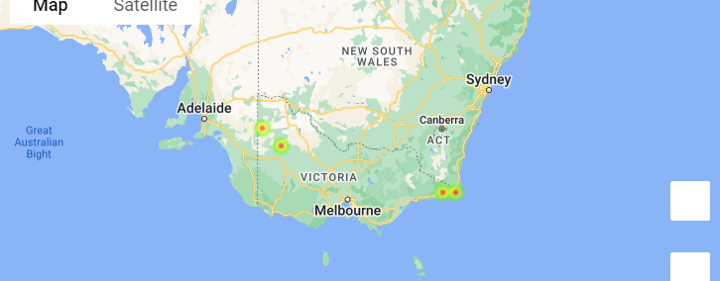
School Geolocation heatmap Remote

Slide 19
Access to education from Geolocation

Slide 20
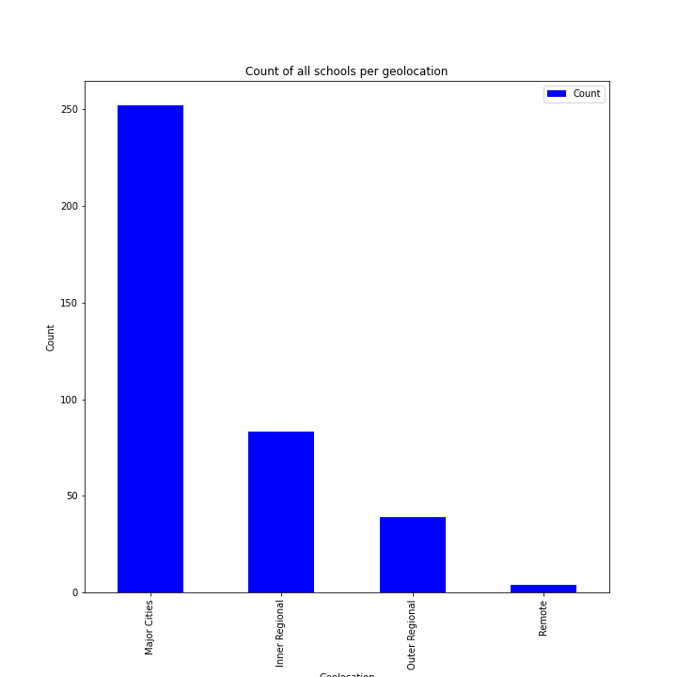
Count of all schools per Geolocation

Slide 21
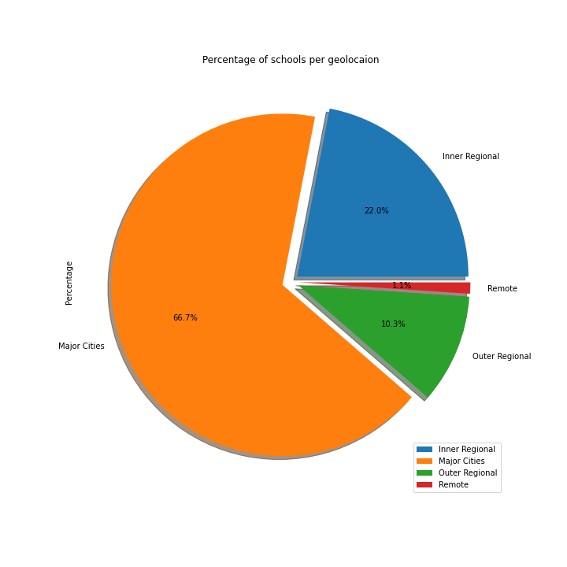
Percentage of schools per Geolocation

Slide 22
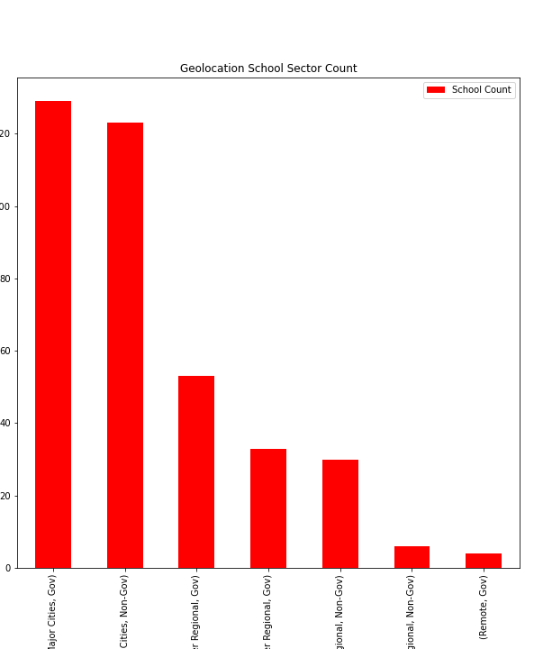
Geolocation School sector count
Which students has more choices of schools between gov or non gov?
Number of school
Number of Gov and Non-gov

Slide 23
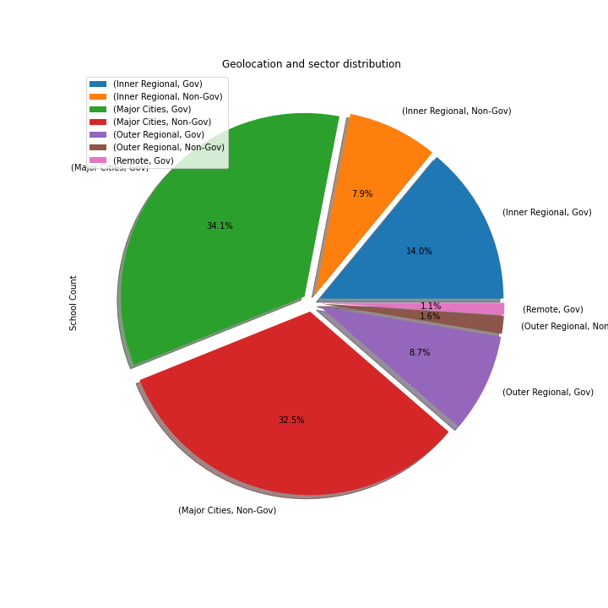
Geolocation and sector distribution

Slide 24
Geolocation and academic success

Slide 25
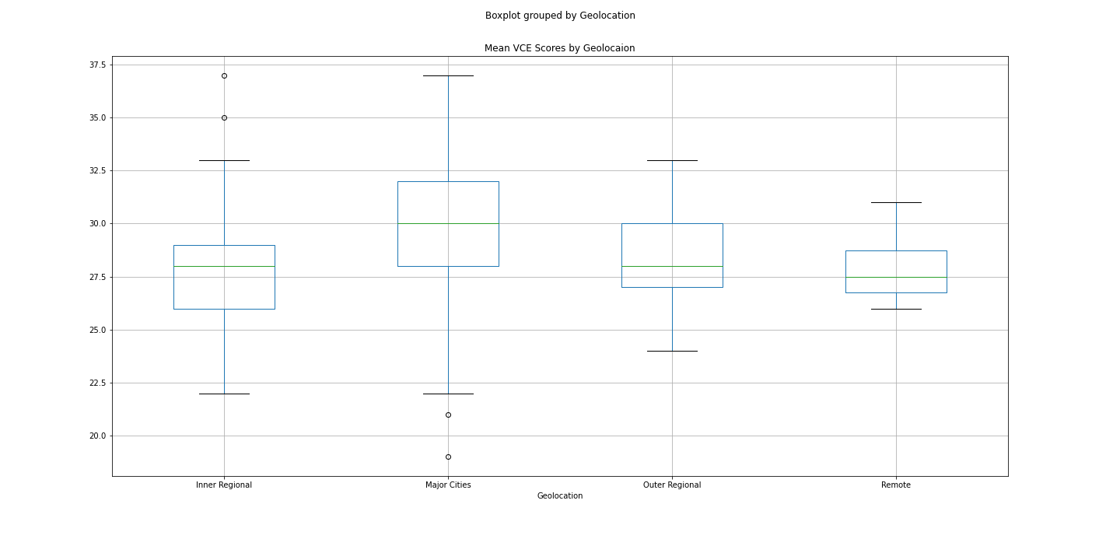
Mean VCE Box Plotting

Slide 26
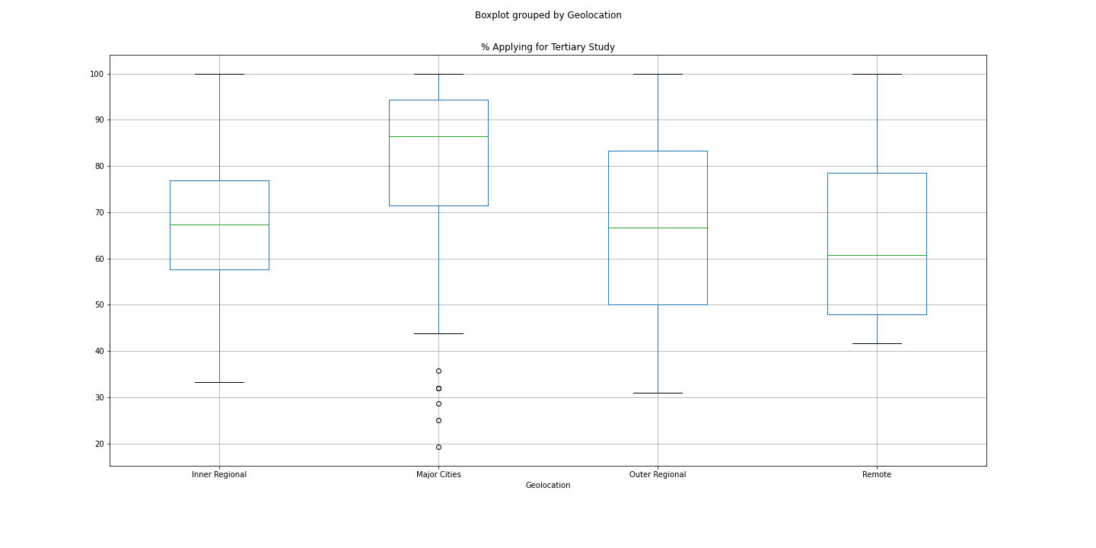
Boxplot grouped by Geolocation

Slide 27
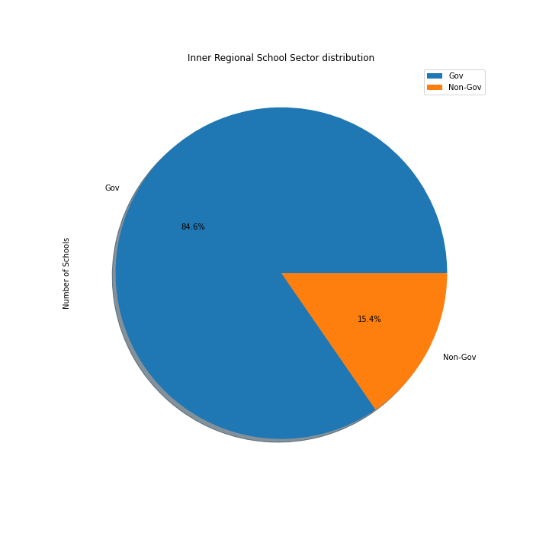

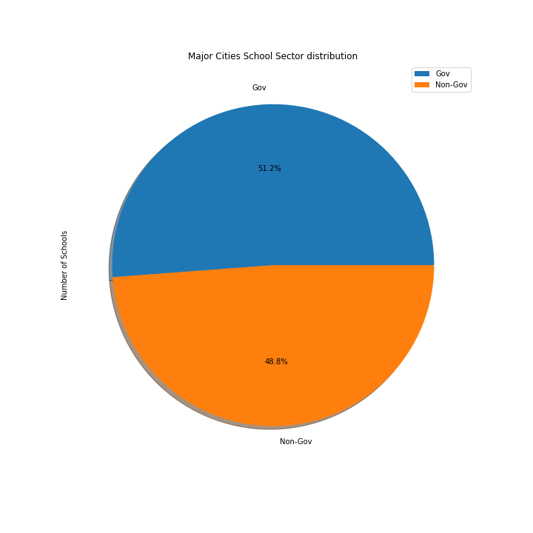
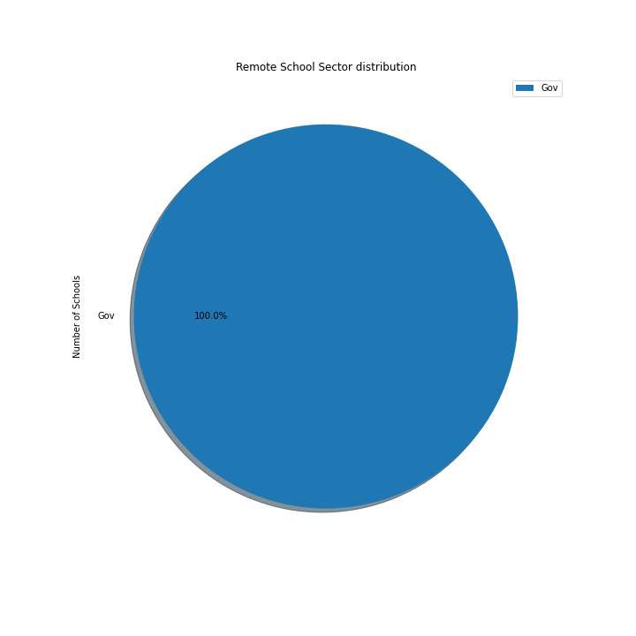
Pie Charts

Slide 28


Slide 29
ANSWERS
Is there a relationship with Geolocation academic success?
YES, Schools closer to Major Cities have better academic performance.
Is there a relationship with Geolocation and the choices of schools?
YES, There are more schools closer to Major Cities than regional Victoria
Which school sector has their best academic success?
Non-Gov school sector had their best academic success.

Slide 30

Conclusion

Slide 31

Conclusion
After collecting processing and analysing the data we can confirm our hypothesis that in fact students within the Major Cities also receive Non-Gov education do have higher average academic performance.

Slide 32
Data Sources: https://asl.acara.edu.au/about-asl - https://bettereducation.com.au/results/VCE_ATAR.aspx -

Slide 33

Group 6
Josh Martin
Peregrin Ryan
Udeshi Pereira

